Slide 1
Data Communication and Computer Networks (CSS 2102)

Slide 2
What is Data communication?
It is the physical transfer of data over a point to point or point to multipoint communication channel.
Data communications deals with the transmission of signals in a reliable and efficient manner
Networking deals with the technology and architecture of the communications networks used to interconnect communicating devices.
Three different forces have consistently driven the architecture and evolution of data communications and networking facilities:
  Traffic growth
  Development of new services
  Advances in technology.
.
Notes:
Here's a more detailed look at the key developments:
1. AI-Powered Networks:
AI is becoming integral to network operations, enabling intelligent monitoring, predictive maintenance, and automated troubleshooting.
AIOps (Artificial Intelligence for IT Operations) is transforming network management, allowing for more efficient and proactive handling of network issues.
AI-driven automation will handle a significant portion of network operations, detecting and resolving issues with minimal human intervention.
2. Multi-Cloud Networking:
Organizations are adopting multi-cloud strategies, requiring seamless connectivity and unified management across different cloud environments.
Multi-cloud networking solutions will simplify connectivity and enhance security across diverse cloud providers.
By 2025, a large percentage of companies are expected to have integrated multi-cloud networking and security management platforms.
3. Convergence of Networking and Security (SASE):
Secure Access Service Edge (SASE) is redefining how enterprises safeguard their network connections.
SASE combines network and security functions into a cloud-delivered service, offering enhanced security and flexibility.
This convergence is crucial for supporting remote work and protecting data across distributed networks.
4. Edge Computing and IoT:
Edge computing is becoming increasingly important for processing data closer to its source, enabling real-time applications and analytics.
The growth of IoT devices is driving the need for edge computing solutions to handle the massive influx of data.
Edge computing will be vital for applications in smart cities, industrial automation, and remote healthcare.
5. 5G and Private Networks:
5G is transforming wireless connectivity with faster speeds, lower latency, and enhanced capacity.
Private 5G networks are emerging as a solution for mission-critical applications in industries like manufacturing and logistics.
5G will enable new applications in areas like augmented reality, virtual reality, and the metaverse.
6. Network as a Service (NaaS):
NaaS is gaining popularity due to its flexibility, scalability, and cost-effectiveness.
Organizations are increasingly turning to NaaS solutions to meet their evolving network needs.
The NaaS market is projected to grow significantly in the coming years.
7. Network Automation and Programmability:
Network automation is crucial for improving efficiency, reducing errors, and streamlining network management.
Software-Defined Networking (SDN) and Network Functions Virtualization (NFV) are key technologies for network automation.
Programmable networks allow for greater flexibility and customization to meet specific business requirements.
8. Other Notable Trends:
Quantum Networking:
Early research and development in quantum networking is underway, with the potential to revolutionize secure communication.
Sustainability in Networking:
Energy-efficient devices and green networking practices are becoming increasingly important for aligning with environmental, social, and governance (ESG) goals.
.

Slide 3
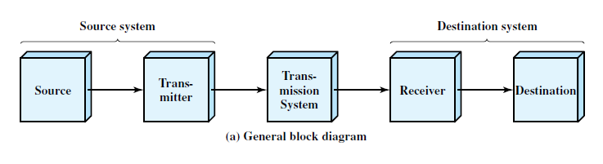
1.2 A COMMUNICATIONS MODEL
Fundamental purpose of a communications system is the exchange of data between two parties.
simple model of communications
.

Slide 4
Source.
  Generates the data to be transmitted;
  Examples : telephones and personal computers.
Transmitter:
  Data generated by a source are not transmitted directly in the form in which they were generated.
  Transmitter transforms the information to produce electromagnetic signals that can be transmitted across some sort of transmission system.
  Modem takes a digital bit stream and transforms that bit stream into an analog signal that can be handled by the telephone network.
Transmission system:
  This can be a single transmission line or a complex network connecting source and destination.
Receiver:
  Receiver accepts the signal from the transmission system and converts it into a form that can be handled by the destination device.
  Example : Modem accept an analog signal from transmission line and convert it into a digital bit stream.
Destination: Takes the incoming data from the receiver.
.

Slide 5
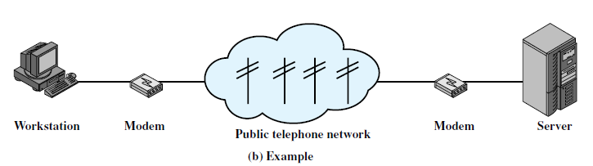
Exchange of voice signals between two telephones over the same network.
Communication between a workstation and a server over a public telephone network.
.

Slide 6
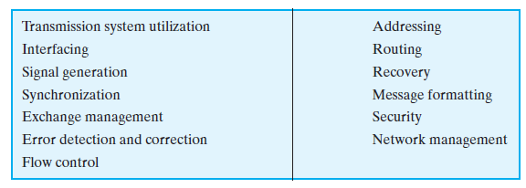
Communication Tasks
Table 1.1 Communications Tasks
items on the list could be merged;
.

Slide 7
Transmission system utilization
Need to make efficient use of transmission facilities that are typically shared among a number of communicating devices.
Various techniques (multiplexing) are used.
To communicate, a device must interface with the transmission system.
Once an interface is established, signal generation is required for communication.
There must be some form of synchronization between transmitter and receiver.
  Receiver must be able to determine when a signal begins to arrive and when it ends.
  It must also know the duration of each signal element
.

Slide 8
Variety of requirements for communication between two parties that might be collected under the term exchange management.
If data are to be exchanged in both directions over a period of time, the two parties must cooperate.
Telephone conversation
One party must dial the number, causing signals to be generated that result in the ringing of the called phone. Other party completes a connection by lifting the receiver.
For data processing devices, more will be needed than simply establishing a connection. i.e certain conventions must be decided on.
These conventions may include :
  whether both devices may transmit simultaneously or must take turns,
  the amount of data to be sent at one time,
  the format of the data, and
  what to do if certain contingencies such as an error arise.
.

Slide 9
Two more items must be included under exchange management:
  Error detection and correction
  Flow control.
addressing and routing.
When more than two devices share a transmission facility, a source system must indicate the identity of the intended destination.
A specific route through this network must be chosen.
.

Slide 10
Recovery is a concept distinct from that of error correction.
Needed in situations, such as a database transaction or file transfer, is interrupted due to a fault somewhere in the system.
The objective is either to be able to resume activity at the point of interruption or at least to restore the state of the systems.
Message formatting : agreement between two parties as to the form of the data to be exchanged or transmitted.
.

Slide 11
It is important to provide some measure of security in a data communications system.
The sender of data may wish to be assured that only the intended receiver actually receives the data.
The receiver of data may wish to be assured that the received data have not been altered in transit and that the data actually come from the purported sender.
Data communications facility is a complex system that cannot create or run itself.
Network management capabilities are needed to configure the system, monitor its status, react to failures and overloads, and plan intelligently for future growth.
.

Slide 12
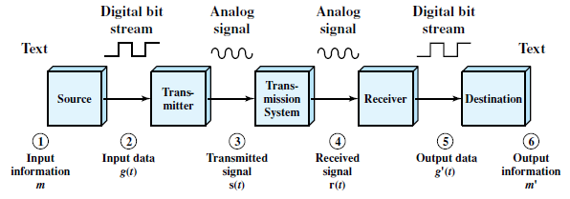
A Data Communications Model
The user of the PC wishes to send a message m (E-mail) to another user.
The input device and transmitter are components of a personal computer.
.

Slide 13
A Data Communications Model
User entered message can be viewed as a sequence of bits (g) in memory.
Input data are transferred to the transmitter as a sequence of voltage shifts [g(t)] representing bits on some communications bus or cable.
The transmitter is connected directly to the medium and converts the incoming stream [g(t)] into a signal [s(t)] suitable for transmission.
Transmitted signal s(t) in the medium is subject to a number of impairments.
Thus, the received signal r(t) may differ from s(t).
Receiver will attempt to estimate the original s(t), based on r(t) and its knowledge of the medium, producing a sequence of bits g¹(t)
These bits are sent to the output personal computer, where they are briefly buffered in memory as a block of bits (g¹)
.

Slide 14
Transmission modes: Simplex, Half Duplex, Full Duplex
Transmission mode defines the direction of flow of signal between two connected devices.
Simplex
Communication between sender and receiver occurs only in one direction.
Ex Television broadcasting
Half Duplex
Communication between sender and receiver occurs in both the directions but, one at a time.
Ex: Walkie-Talkies
Full Duplex
The communication between sender and receiver can occur simultaneously.
For example, in a telephone, two people communicate.
.

Slide 15
Analog and Digital Data
Data can be analog or digital.
Analog data have continuous values over a time.
  sound made by a human voice.
  When someone speaks, an analog wave is created in the air.
  Captured by a microphone.
Digital data takes discrete value.
  data are stored in computer memory in the form of Os and 1s
Data is an entity that conveys some meaning based on some mutually agreed up rules/conventions between a sender and a receiver.
.

Slide 16
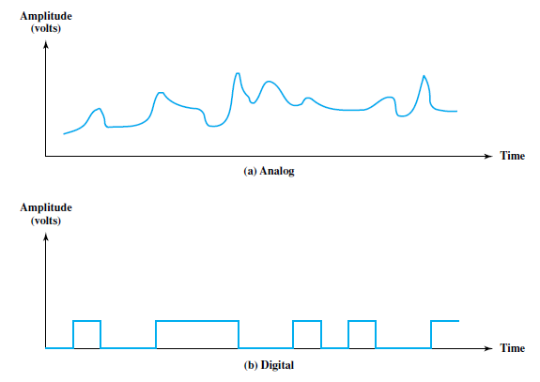
Analog and Digital Signals
Signal : is a electric, electromagnetic or optical representation of data which can be sent over a communication media.
Signals can be either analog or digital.
Analog signal : signal intensity varies in a smooth fashion over time. An analog signal
has infinitely many levels of intensity over a period of time.
Digital signal : signal intensity maintains a constant level for some period of time and then abruptly changes to another constant level.
.

Slide 17
Periodic and Nonperiodic Signals
Both analog and digital signals can take one of two forms: periodic or nonperiodic (aperiodic).
Periodic signal: completes a pattern within a measurable time frame, called a period, and repeats that pattern over subsequent identical periods.
Completion of one full pattern is called a cycle.
Nonperiodic signal: changes without exhibiting a pattern or cycle that repeats over time.
.

Slide 18
PERIODIC ANALOG SIGNALS
Periodic analog signals can be classified as simple or composite.
A simple periodic analog signal, a sine wave, cannot be decomposed into simpler signals.
A composite periodic analog signal is composed of multiple sine waves.
.

Slide 19

PERIODIC ANALOG SIGNALS
Sine Wave
Is the most fundamental form of a periodic analog signal.
A sine wave can be represented by three parameters: the peak amplitude, the frequency, and the phase.
Figure 3.2 A sine wave
.

Slide 20

PERIODIC ANALOG SIGNALS
Sine Wave : Peak Amplitude
The peak amplitude of a signal is the absolute value of its highest intensity, proportional to the energy it carries.
Figure 3.3Two signals with the same phase and frequency, but different amplitudes
.

Slide 21

PERIODIC ANALOG SIGNALS
Sine Wave : Period and Frequency
Period refers to the amount of time ( in seconds ) a signal needs to complete 1 cycle.
Frequency refers to the number of periods in I s.
period and frequency are just one characteristic defined in two ways.
.

Slide 22

PERIODIC ANALOG SIGNALS
Sine Wave : Period and Frequency
Figure : Two signals with the same amplitude and phase, but different frequencies
.

Slide 23
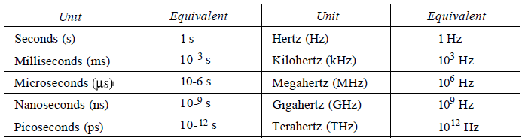
PERIODIC ANALOG SIGNALS
Sine Wave : Period and Frequency
Period is formally expressed in seconds.
Frequency is formally expressed in Hertz (Hz), which is cycle per second.
Table 3.1 Units of period and frequency
.

Slide 24

PERIODIC ANALOG SIGNALS
Sine Wave
Period and Frequency
The power we use at home has a frequency of 60 Hz.
The period of this sine wave can be determined as follows:
Period of the power for our lights at home is 16.6 ms.
Our eyes are not sensitive enough to distinguish these rapid changes in amplitude.
.

Slide 25
PERIODIC ANALOG SIGNALS
Sine Wave
Period and Frequency
Frequency is the rate of change with respect to time.
Change in a short span of time means high frequency.
Change over a long span of time means low frequency.
If a signal does not change at all, its frequency is zero. (Constant Voltage-never completes cycle)
If a signal changes instantaneously, its frequency is infinite.(when a signal changes instantaneously, its period is zero; since frequency is the inverse of period, in this case, the frequency is 1/0, or infinite (unbounded).)
.

Slide 26
To solve
Express a period of 100 ms in microseconds
The period of a signal is 100 ms. What is its frequency in kilohertz?

Slide 27

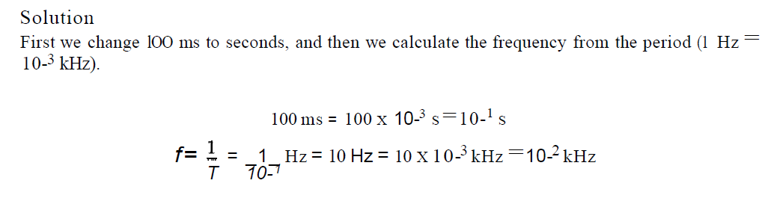
Answers
1.
2.

Slide 28
PERIODIC ANALOG SIGNALS
Sine Wave
Phase
The term phase describes the position of the waveform relative to time O.
It indicates the status of the first cycle.
If we think of the wave as something that can be shifted backward or forward along the time axis, phase describes the amount of that shift.
.

Slide 29
PERIODIC ANALOG SIGNALS
Sine Wave
Phase
Phase is measured in degrees or radians.
A phase shift of 360° corresponds to a shift of a complete period;
a phase shift of 180° corresponds to a shift of one-half of a period;
and a phase shift of 90° corresponds to a shift of one-quarter of a period.
.

Slide 30

PERIODIC ANALOG SIGNALS
Sine Wave
Phase
Figure 3.5 Three sine waves with the same amplitude and frequency, but different phases
A sine wave with a phase of 0° is not shifted.
A sine wave with a phase of 90° is shifted to the left by 1/4 cycle.
A sine wave with a phase of 180° is shifted to the left by 1/2 cycle
.

Slide 31
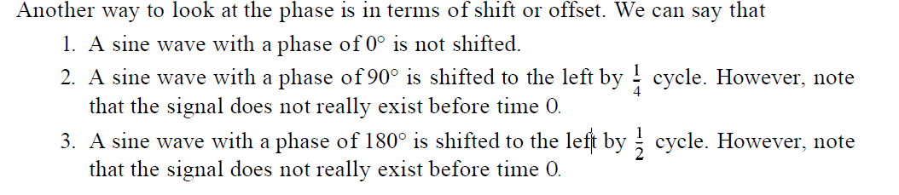
PERIODIC ANALOG SIGNALS
Sine Wave
Phase
.

Slide 32

PERIODIC ANALOG SIGNALS
Sine Wave
Phase
A sine wave is offset 1/6 cycle with respect to time O. What is its phase in degrees and radians?
Solution
We know that 1 complete cycle is 360°. Therefore, 1/6 cycle is
1/6 * 360 = 60 = 60 * rad = rad = 1.046 rad.
.

Slide 33

Time and Frequency Domains
A sine wave is comprehensively defined by its amplitude, frequency, and phase.
The time-domain plot shows changes in signal amplitude with respect to time
(amplitude-versus-time plot).
.

Slide 34
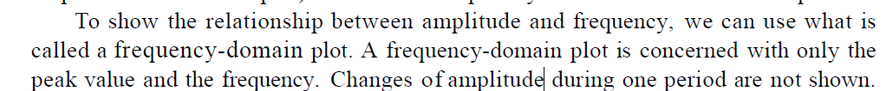
Time and Frequency Domains
Frequency domain plot conveys the information that one can find in a time domain plot.
The advantage of the frequency domain is that we can immediately see the values of the frequency and peak amplitude.
The frequency domain is more compact and useful when we are dealing with more than one sine wave.
.

Slide 35

Time and Frequency Domains
Figure shows three sine waves, each with different amplitude and frequency.
All can be represented by three spikes in the frequency domain..
Figure 3.8 The time domain and frequency domain of three sine waves
.

Slide 36
Composite Signals
A single a frequency sine wave is not useful in data communications;
We need to send a composite signal to communicate data.
A composite signal is made of many simple sine waves.
In the early 1900s, the French mathematician Jean-Baptiste Fourier showed that any composite signal is actually a combination of simple sine waves with different frequencies, amplitudes, and phases.
.

Slide 37
Composite Signals
A composite signal can be periodic or nonperiodic.
If the composite signal is periodic, the decomposition gives a series of signals with discrete frequencies ((1, 2, 3, and so on).
if the composite signal is nonperiodic, the decomposition gives a combination of sine waves with continuous frequencies.
.

Slide 38
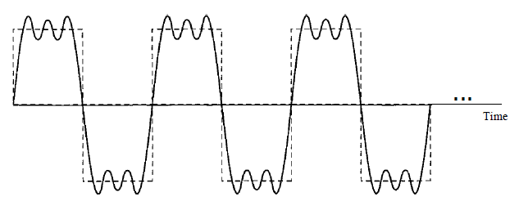
Composite Signals
Figure shows a periodic composite signal with frequency f.
This type of signal is not typical of those found in data communications.
We can consider it to be three alarm systems, each with a different frequency.
Figure 3.9 A composite periodic signal
.

Slide 39
Composite Signals
It is difficult to manually decompose signal into a series of simple sine waves.
There are tools, both hardware and software, that can help us do the job.
Figure 3.10 Decomposition of a composite periodic signal in the time and frequency domains
.

Slide 40
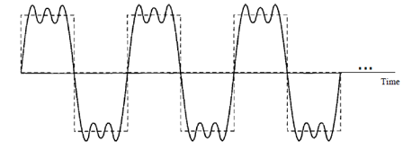
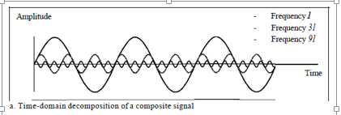
Composite Signals
The amplitude of the sine wave with frequency f is almost the same as the peak amplitude of the composite signal.
The amplitude of the sine wave with frequency 3f is one-third of that of the first, and the amplitude of the sine wave with frequency 9f is one-ninth of the first.
The frequency of the sine wave with frequency f is the same as the frequency of the composite signal; it is called the fundamental frequency, or first harmonic.
.

Slide 41
Composite Signals
The sine wave with frequency 3f has a frequency of 3 times the fundamental frequency; it is called the third harmonic.
The third sine wave with frequency 9fhas a frequency of 9 times the fundamental frequency; it is called the ninth harmonic.
.

Slide 42
Draw the time domain representation of the signal with following parameters.
f=3 A=5 = 0
f=6 A=3 = 0
F=12 A=2 = 0
.

Slide 43
Draw the frequency domain representation of the signal with following parameters.
f=3 A=5 = 0
f=6 A=3 = 0
F=12 A=2 = 0
.

Slide 44
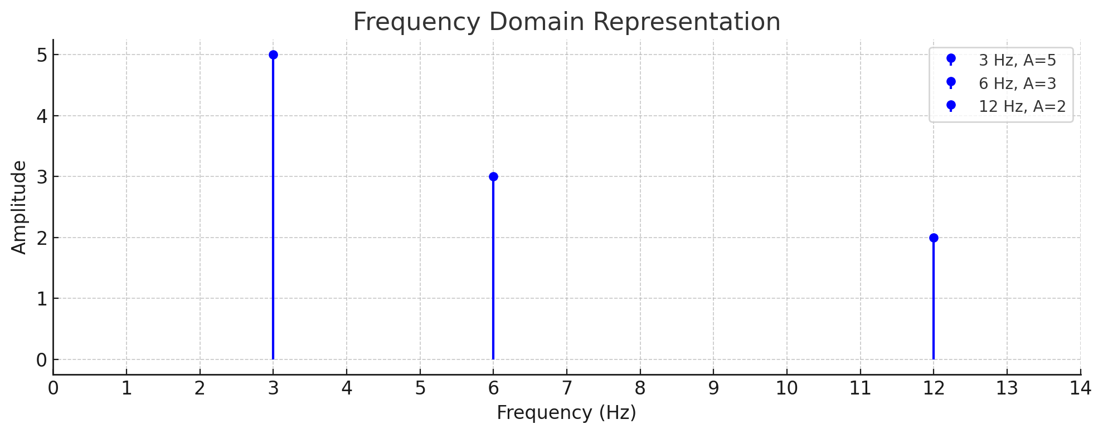
Solution

Slide 45
Periodic analog signal characterized by 3 parameters.
Representation of sine wave
s (t ) = A sin (2πft + φ)
Where A is peak amplitude.
.

Slide 46
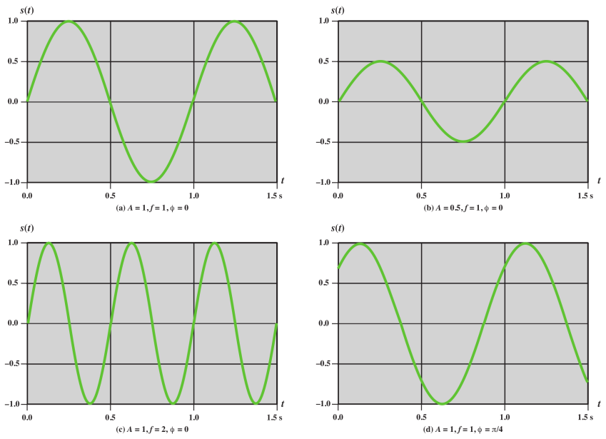
.

Slide 47
UNITS of Parameter
Amplitude : volts, milli (10⁻³) volt, KV(10³)
Frequency : Hz, KHz(10³), MHz(10⁶), GHz(10⁹), THz(10¹²)
Time : second, milli second(10⁻³), micro second(10⁻⁶), ns(10⁻⁹), ps(10⁻¹²)
Phase : degree , radian
.

Slide 48
Composite signals can be expressed as a combination of simple sine waves with different amplitude, frequency and phase.
s (t ) = A₁ sin (2πf₁t + φ₁) + A₂ sin (2πf₂t + φ₂) + A₃ sin (2πf₃t + φ₃) +……..
.

Slide 49
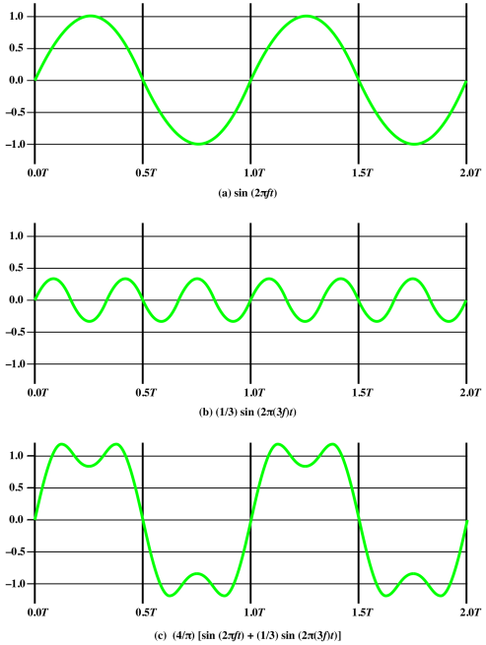
s (t ) = A₁ sin (2πf₁t + φ₁) + A₂ sin (2πf₂t + φ₂) +……..
.

Slide 50
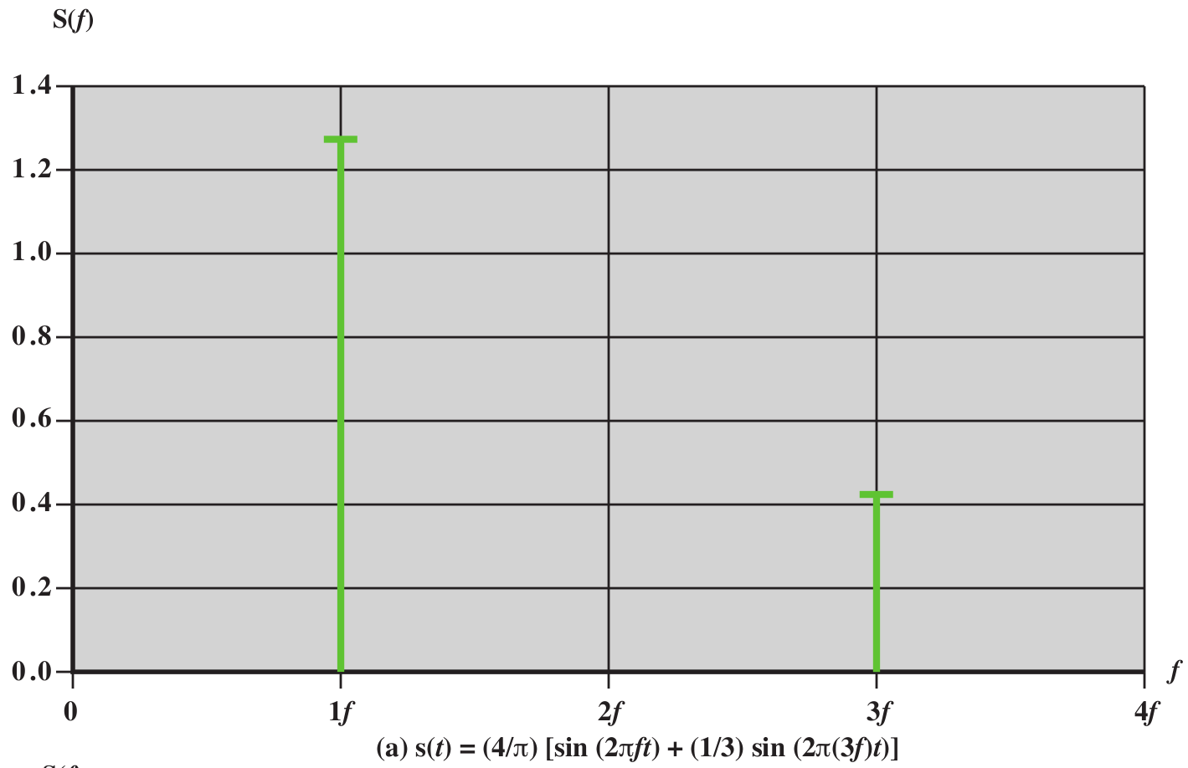
.

Slide 51

Composite Signals
Figure shows a nonperiodic composite signal.
signal created by a microphone or a telephone.
In a time-domain representation of this composite signal, there are an infinite number of simple sine frequencies.
Although the number of frequencies in a human voice is infinite, the range is limited.
A normal human being can create a continuous range of frequencies between 0 and 4 kHz.
.

Slide 52
Frequency Domain Concepts
The spectrum of a signal is the range of frequencies that it contains.
The absolute bandwidth of a signal is the width of the spectrum.
Many signals have an infinite bandwidth.
However, most of the energy in the signal is contained in a relatively narrow band of frequencies.
This band is referred to as the effective bandwidth, or just bandwidth.
.

Slide 53
Bandwidth
The bandwidth of a composite signal is the difference between the highest and the lowest frequencies contained in that signal.
For example, if a composite signal contains frequencies between 1000 and 5000, its bandwidth is 5000 - 1000, or 4000.
.

Slide 54
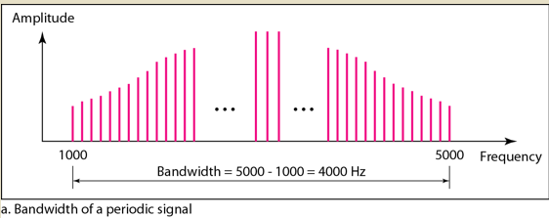
Bandwidth
The figure depicts periodic composite signals.
The bandwidth of the periodic signal contains all integer frequencies between 1000 and 5000 (1000, 100 I, 1002, ...).
Figure 3.12 The bandwidth of periodic composite signals
.

Slide 55
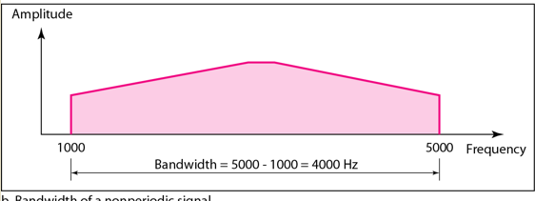
Bandwidth
The figure depicts nonperiodic composite signals.
The bandwidth of the nonperiodic signals has the same range, but the frequencies are continuous.
Figure 3.12 The bandwidth of nonperiodic composite signals
.

Slide 56
Bandwidth
If a periodic signal is decomposed into five sine waves with frequencies of 100, 300, 500, 700, and 900 Hz, what is its bandwidth?
Draw the spectrum, assuming all components have a maximum amplitude of 10 V.
.

Slide 57
Bandwidth
If a periodic signal is decomposed into five sine waves with frequencies of 100, 300, 500, 700, and 900 Hz, what is its bandwidth?
Draw the spectrum, assuming all components have a maximum amplitude of 10 V.
Solution
Let f_{h} be the highest frequency, f_{l} the lowest frequency, and B the bandwidth.
Then B =f_{h} - i_{t} = 900 - 100 =800 Hz
The spectrum has only five spikes, at 100, 300, 500, 700, and 900 Hz.
.

Slide 58

Bandwidth
If a periodic signal is decomposed into five sine waves with frequencies of 100, 300, 500, 700, and 900 Hz, what is its bandwidth?
Draw the spectrum, assuming all components have a maximum amplitude of 10 V.
.

Slide 59
Bandwidth
Example 3.12
A nonperiodic composite signal has a bandwidth of 200 kHz, with a middle frequency of140 kHz and peak amplitude of 20 V.
The two extreme frequencies have an amplitude of 0.
Draw the frequency domain of the signal..
.

Slide 60
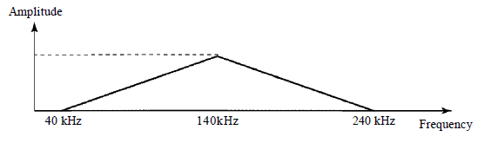
Bandwidth
Example 3.12
A nonperiodic composite signal has a bandwidth of 200 kHz, with a middle frequency of140 kHz and peak amplitude of 20 V.
The two extreme frequencies have an amplitude of 0.
Draw the frequency domain of the signal..
Solution
The lowest frequency must be at 40 kHz and the highest at 240 kHz.
Figure 3.15 shows the frequency domain and the bandwidth.
.

Slide 61
The periodic signal has a bandwidth of 20 Hz. The highest frequency is 60Hz what is the lowest frequency.
Draw the spectrum of the signal which contain all frequencies of same amplitude.
.

Slide 62

The periodic signal has a bandwidth of 20 Hz. The highest frequency is 60Hz what is the lowest frequency.
Draw the spectrum of the signal which contain all frequencies of same amplitude.
.

Slide 63
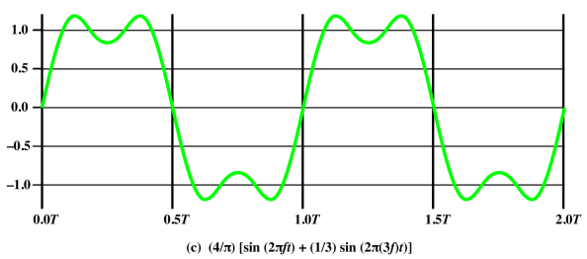
.

Slide 64
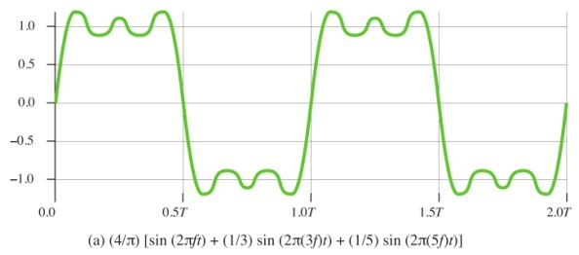
.

Slide 65
.

Slide 66
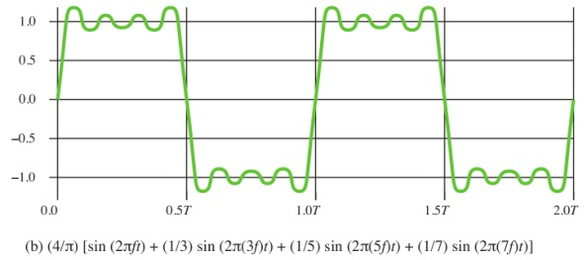
.

Slide 67
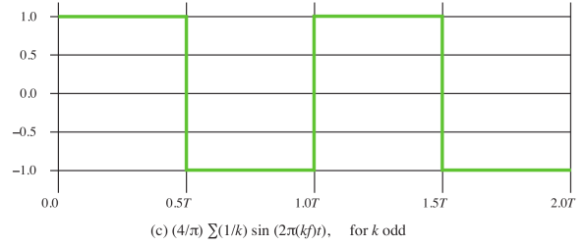
.

Slide 68

The frequency components of the square wave with amplitudes A and can be expressed as follows:
.

Slide 69
Digital signal
Based on Fourier analysis, a digital signal is a composite analog signal.
A digital signal can be considered as a signal with an infinite number of frequencies.
Fourier analysis can be used to decompose a digital signal.
.

Slide 70
Digital signal
Most digital signals are nonperiodic, and thus period and frequency are not appropriate characteristics.
Bit interval
Time required to send a single bit.
.

Slide 71
Digital signal
Bit Rate
Term bit rate (instead of frequency)-is used to describe digital signals.
Number of bits sent in 1 second, expressed in bits per second (bps).
Number of bit intervals per second.
.

Slide 72
Digital signal
A digital signal can have more than two levels.
In this case, we can send more than 1 bit for each level.
.

Slide 73

Digital signal
We send 1 bit per level in part a of the figure and 2 bits per level in part b of the figure.
.

Slide 74
DIGITAL SIGNALS
In general, if a signal has L levels, each level needs log ₂L bits.
.

Slide 75
DIGITAL SIGNALS
A digital signal has eight levels. How many bits are needed per level?
.

Slide 76
DIGITAL SIGNALS
A digital signal has eight levels. How many bits are needed per level?
Number of bits per level =log₂ 8 =3
Each signal level is represented by 3 bits.
.

Slide 77
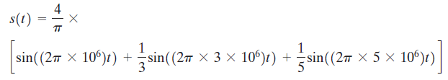
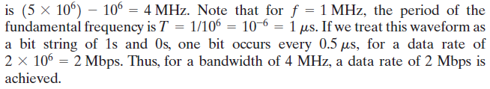
Relationship between Data Rate and Bandwidth
What data rate can be achieved? We look at three cases.
Case I. Let us approximate our square wave with the waveform of Figure 3.7a.
Although this waveform is a “distorted” square wave, it is sufficiently close to the square wave that a receiver should be able to discriminate between a binary 0 and a binary 1.
the signal
.

Slide 78
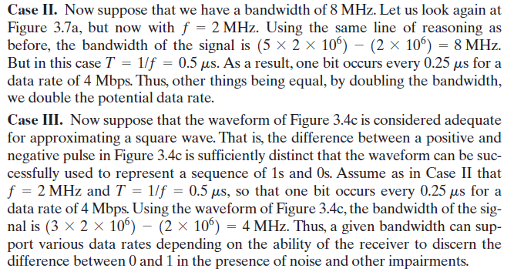
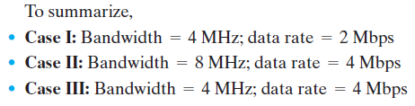
Relationship between Data Rate and Bandwidth
.

Slide 79
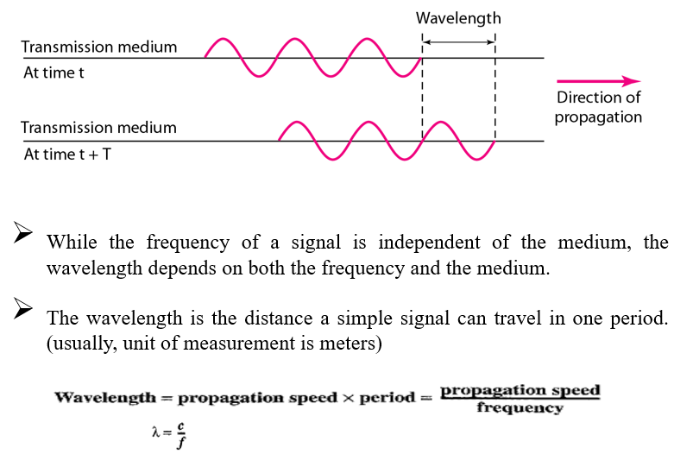
Wavelength
.

Slide 80
Digital Data, Digital Signals
A digital signal is a sequence of discrete, discontinuous voltage pulses.
Each pulse is a signal element.
Binary data are transmitted by encoding each data bit into signal elements.
.

Slide 81
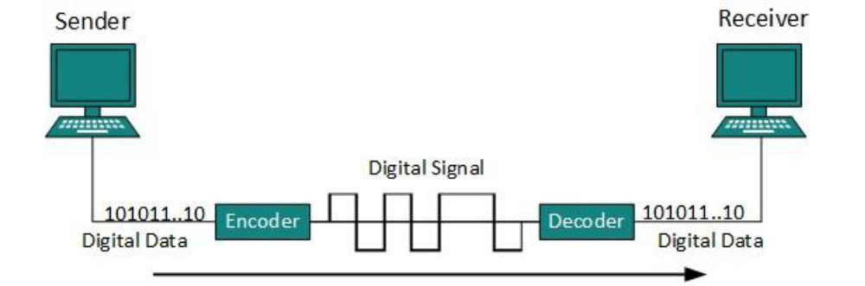
Line Coding
The process for converting digital data into digital signal.
.

Slide 82
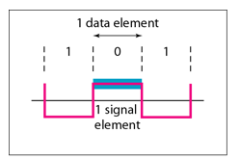
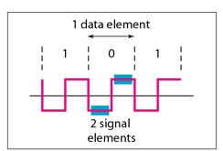
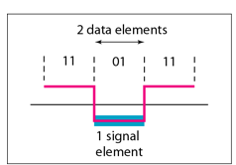
Signal level and Data level
signal level : Number of values allowed in a particular signal. (voltage level)
Data level : Number of values to represent data.
For binary two values 0 and 1.
.

Slide 83
Pulse rate and bit rate
Pulse rate : number of pulses per second.
Bit rate : number of bits per second.
If one pulse corresponds to one bit then pulse rate equal to bit rate.
If the pulse carries more than 1 bit, then pulse rate is lower than bit rate.
bit rate = pulse rate X log₂ L
.

Slide 84
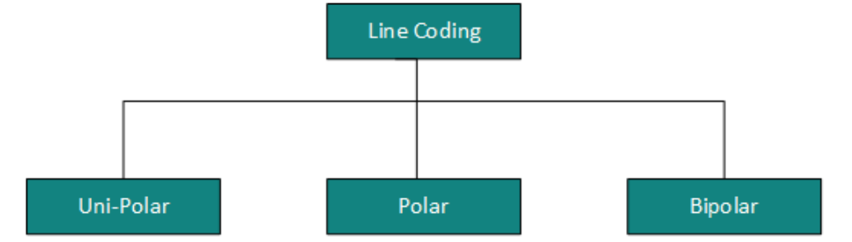
Line Coding
There are three types of line coding schemes available:
.

Slide 85
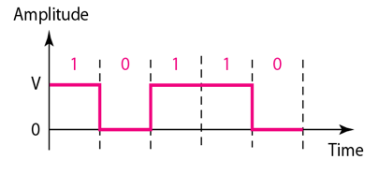
Uni Polar
All the signal levels are on one side of the time axis, either above or below.
Uses single voltage level to represent data.
In this case,
  To represent binary 1 high voltage is transmitted
  To represent 0 no voltage is transmitted.
Also called Unipolar-Non-return-to-zero, because there’s no rest condition
.

Slide 86
Polar
In polar schemes, the voltages are on both sides of the time axis.
Polar encodings are available in four types:
Polar-NRZ ( Non Return to Zero)
Polar-RZ (Return to Zero)
Manchester
Differential Manchester.
.

Slide 87
BiPolar
Bipolar encoding uses three levels.
ie positive, zero and negative.
Zero level represent binary ‘0’ and alternating positive and negative voltage represents binary ‘1’.
.

Slide 88
POLAR-NRZ (NON-RETURN TO ZERO)
It uses 2 different voltage levels – one positive and other is negative.
Voltage level is constant during bit interval.
NRZ scheme has two variants:
NRZ- L
NRZ - I
.

Slide 89
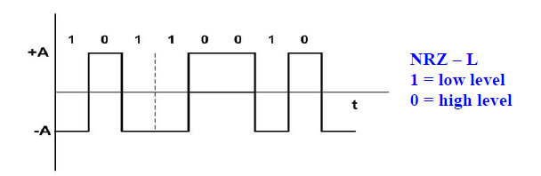
NRZ-L
NRZ-L changes voltage level at when a different bit is encountered
.

Slide 90
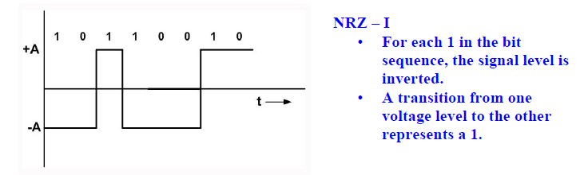
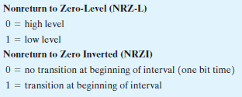
NRZ - I
NRZ-I changes voltage when a 1 is encountered.
.

Slide 91
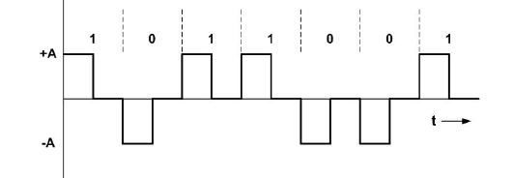
POLAR-RZ (RETURN TO ZERO)
Synchronization is the major concern in previous techniques (NRZ)
To overcome that we can use RZ encoding
Here to ensure synchronization, there must be signal transition in each bit
.

Slide 92
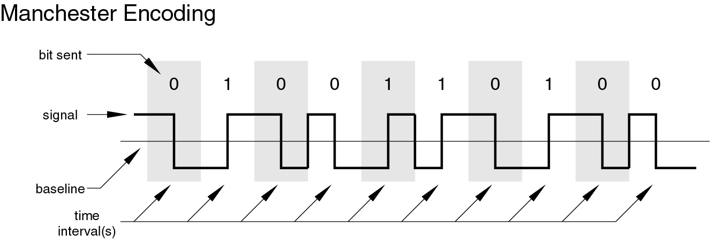
MANCHESTER (Biphase) ENCODING
In the Manchester code, there is a transition at the middle of each bit period.
low-to-high transition represents a 1
high-to-low transition represents a 0
Limitation: number of transition is more for consecutive zeros and consecutive ones.
.

Slide 93
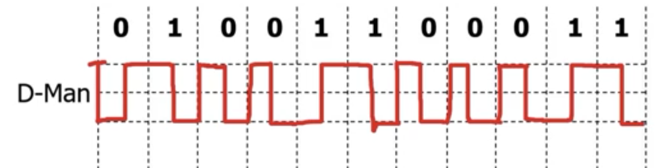
DIFFERENTIAL MANCHESTER ENCODING
There is always a transition at the middle of the bit, but the bit values are determined at the beginning of the bit.
If the next bit is 0, there is a transition.
If the next bit is 1, there is none.
.

Slide 94
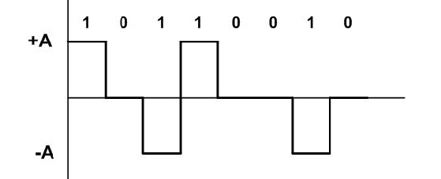
Bipolar
Bipolar AMI (Amplitude Mark Inversion)
Bipolar AMI uses 3 voltage levels.
The zero level is used to represent 0.
Binary 1’s are represented by alternating positive and negative voltage.
Loss of synchronization for long sequence of 0’s
.

Slide 95
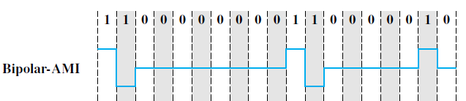
Bipolar
Bipolar AMI (Amplitude Mark Inversion)
.

Slide 96
Bipolar
Pseudoternary
Same as AMI, but alternating positive and negative pulses occur for 0 instead of 1.
.

Slide 97
For the 11 bit binary string 01001100011 find the number of transitions for the following encoding schemes.
NRZ-L
NRZI
Bipolar-AMI
Pseudoternary
Manchester
Differential Manchester
.

Slide 98
For the 11 bit binary string 01001100011 find the number of transitions for the following encoding schemes.
NRZ-L 5
NRZI 5
Bipolar-AMI 7
Pseudoternary 8
Manchester 16
Differential Manchester 16
.

Slide 99
Tutorial 1
For the given binary string 1110100110001 draw the line coding schemes
Unipolar
NRZ-L
NRZI
Polar RZ
Manchester
.

